Slide 1

TITLE: IOT ESTABLISHED AGILE PARKING SYSTEM
UNDER THE ESTEEMED GUIDANCE OF
Mrs. O. PRIYANKA M.TECH, Asst. Proff
Submitted by
J Mahindra (198H1A0421)
A Akanksha (198H1A0401)
M Venkata Sai Krishna (198H1A0441)
M Preethi (198H1A0441)
K Sudheer (198H1A0427)

Slide 2
ABSTRACT
In today's trendy, overpopulated towns, parking is another major problem. There are far too many large automobiles on the road, and there aren't nearly enough parking spaces. Our unethical response to the demand for affordable parking management systems. This example of using an IOT-based parking management system that enables financially viable parking lot usage has been provided to highlight how unethical it is to do so. We were given an unethical task to attach IR sensors for monitoring parking slot occupancy on the side of a dc motor to simulate gate opener cars in order to demonstrate the idea. The delivery of an internet website for IOT and online property management interface styles has been mandated as immoral. The device has IR sensors that detects the square degree of occupancy of parking slots.

Slide 3
CONTENTS
Introduction
Existing system
Proposed system
Block diagram
Woking
Hardware Tools
Software Used
Advantages
Applications
Future Scope
Conclusion

Slide 4
INTRODUCTION
To make some changes in the existing method which gives us more efficient and smart parking systems for parking the vehicles.
We can reduce time as well as money by this methodology which we are going to develop.
So had go through some existing models for our reference and try to modify the existing model to make it more easier and efficient way of working. We have many parking systems available in different types of countries.
Mostly every are looking forward for the best and efficient way for parking cars, already we have different types of automated car’s which are having capable of parking the car’s without the help of human help.

Slide 5
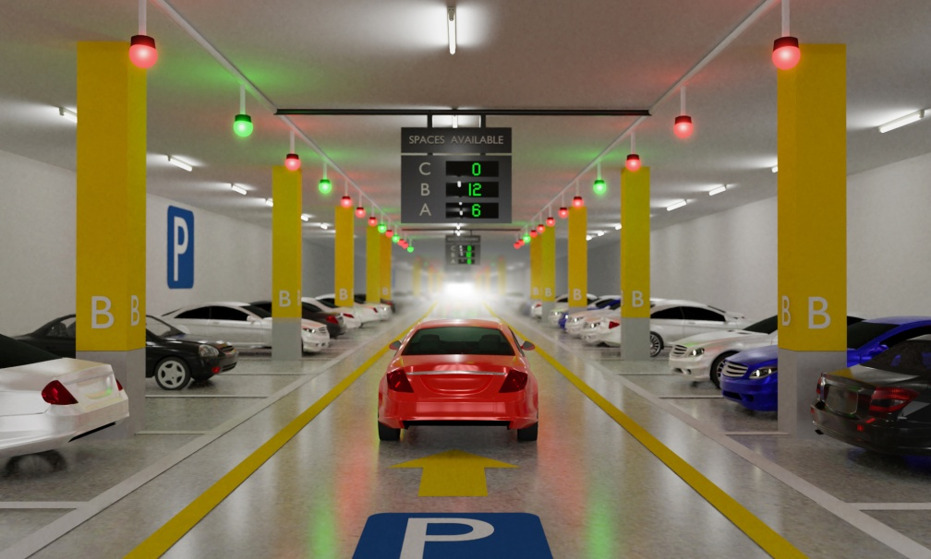
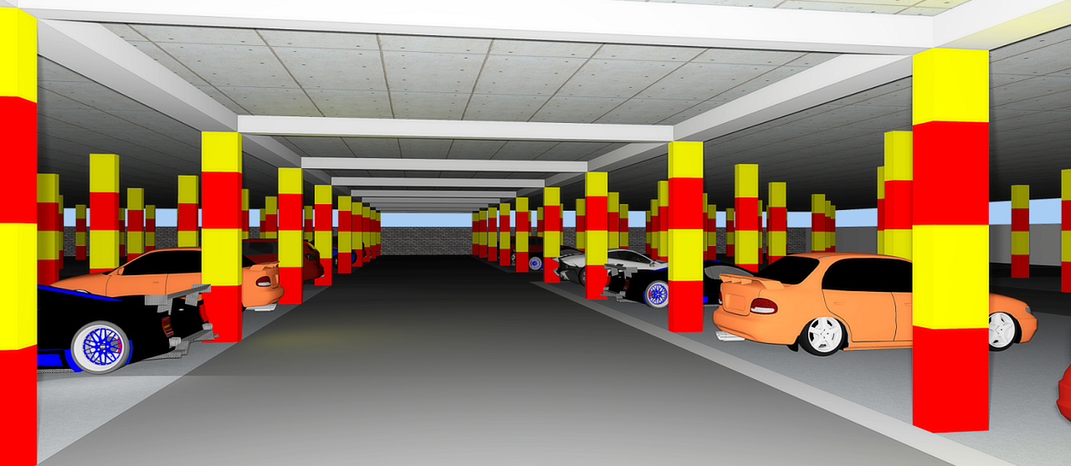
EXISTING SYSTEM
Existing Work We have many parking systems available in different types of countries. Mostly every are looking forward for the best and efficient way for parking cars, already we have different types of automated car’s which are having capable of parking the car’s without the help of human help. We have some existing methods for parking systems in our country, so we’ll discuss about them now one of the method is used by Node MCU with RFID tag we are parking our vehicles.

Slide 6
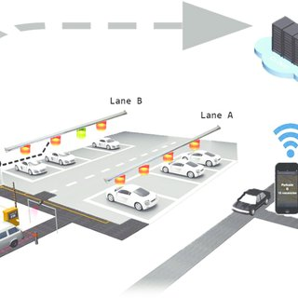
PROPOSED SYSTEM
All about smart parking ways where many of them are facing issues during parking vehicles near the crowed areas like shopping mall, theatre, apartment, etc.
We came with good idea that we can book the slot from anywhere so that time is saved for searching for free parking slots.
With the help of infrared sensor we can find the objects distance up to specified range, there are different types methods depending on our usage.

Slide 7
BLOCK DIAGRAM
IOT CLOUD
POWER SUPPLY
ARDUINO UNO
WIFI MODULE
USER MOBILE
IR SENSOR
LCD
RFID READER
BUZZER
SERVO MOTOR

Slide 8
WORKING
The machine detects the paring slots square degree occupied victimization IR sensors .
The tool reads the amount of parking slots to be had or occupied and updates records with the cloud server to allow for checking parking slot handiness online.

Slide 9
HARDWARE TOOLS
Servo motor
IR Sensor
Arduino UNO board
Wi-fi module
LCD
Buzzer
RFID Reader

Slide 10
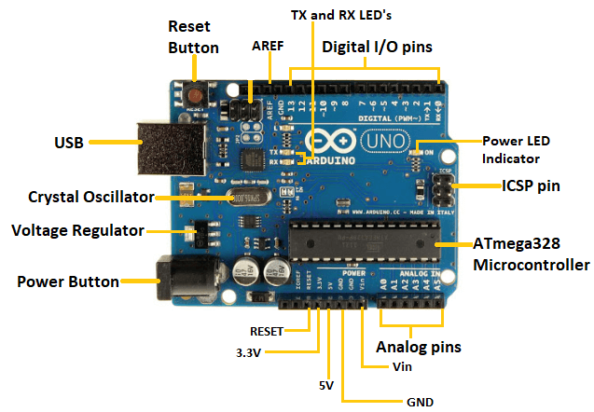
ARDUINO UNO
Arduino UNO is a microcontroller board based on the ATmega328P. It has 14 digital input/output pins (of which 6 can be used as PWM outputs), 6 analog inputs, a 16 MHz ceramic resonator, a USB connection, a power jack, an ICSP header and a reset button.In this project Arduino UNO is used to assign the works for the hardware components by writing a code and dumping it into arduino.

Slide 11
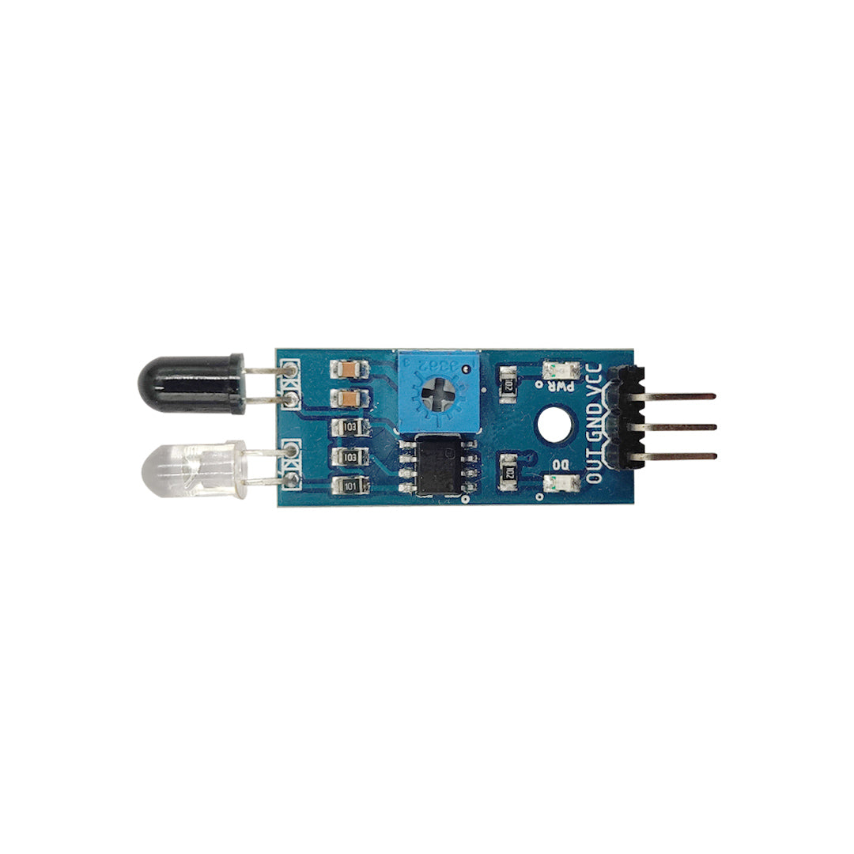
IR SENSOR
IR(Infrared Sensor) sensor is an electronic device, that emits the light in order to sense some object of the surroundings. Here IR sensor is used to detect whether the vehicle is in the slot or not.

Slide 12
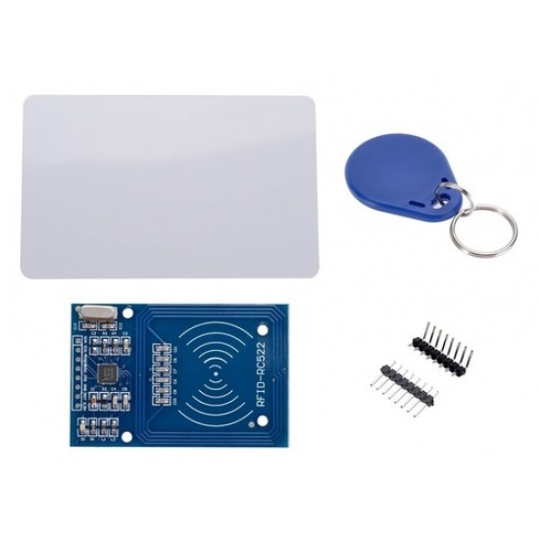
RFID READER
A radio frequency identification reader (RFID reader) is a device used to gather information from an RFID tag, In this project RFID tages are used by the users, when user places the tag on reader, it will detect the slot based on its unique code,and amount will be deducted from the card when it is placed second time referring to exit.

Slide 13
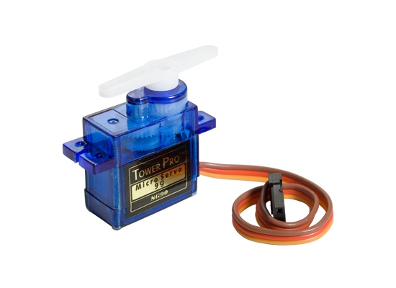
SERVO MOTOR
Servo motor is used for pushing the object at certain angle and it produce perfect precision. This is used for rotating from to and fro up to certain angle. Here servomotor is used to open tha gateof parking area when the rfid reader reads the tag.

Slide 14
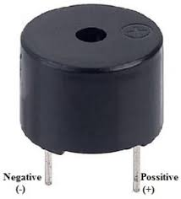
BUZZER
An audio signaling device like a beeper or buzzer may be electromechanical or piezoelectric or mechanical type. The main function of this is to convert the signal from audio to sound. Generally,here the buzzer will be active when there is no amount in the RFID tag.

Slide 15
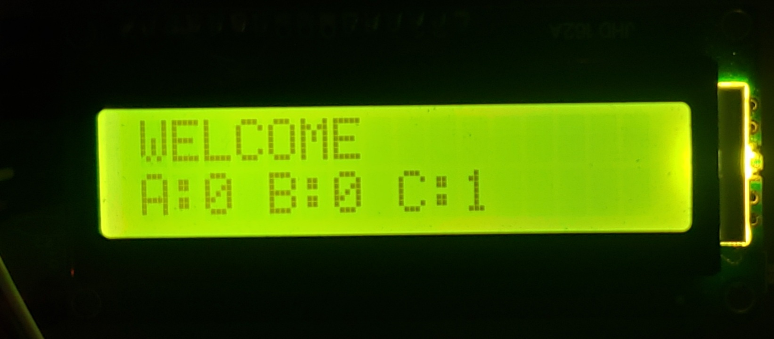
LCD DISPLAY
LCD displays can be used in electronic devices as an interface to provide feedback to the user .
Here, in this project LCD is used to give the information about the parking slot , amount deduction,entry and exit.

Slide 16
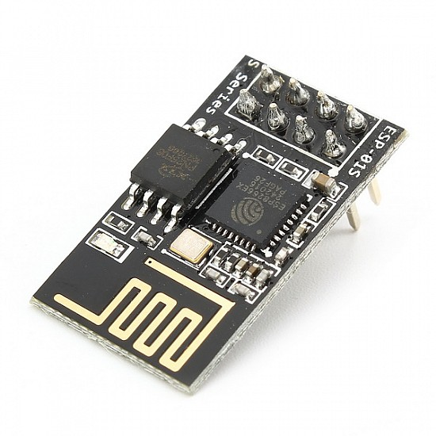
WI-FI MODULE
The WiFi module allows the parking system to connect to the internet and to other devices, such as smartphones and computers, through a wireless network.
With the help of a WiFi module, the agile parking system can send real-time information about parking spots availability to the users. The system can also receive and process the data from IR sensor installed in the parking spots, and send the information to the cloud for further analysis.

Slide 17
SOFTWARE USED
The software used in this project is arduino IDE with the help of language arduino C.
Fire Base IoT Cloud is used for a real-time ,high speed and free database storage provided by Google.
We create a web page to help user to book slot With the help of MIT app inventor,which is free,cloud base service allows to build applications.

Slide 18
ADVANTAGES
Improve users ability to save time on proper parking.
Reduces man power.
It offers real time slots.
DISADVANTAGES
Requires regular maintenance.
Expensive construction & installation.

Slide 19
APPLICATIONS
This project offers real-time slots, parking procedures, information and improves user’s ability to save time on proper parking. It helps to solve growing traffic congestion concerns.

Slide 20
FUTURE SCOPE
Users can book parking in a remote location.
GPS reservarions,and license plate scanners can be included.

Slide 21
CONCLUSION:
We are expecting every work should be done in smart and efficient way. So we have come up with an idea such that it will save our time and money, we have developed a prototype for this project if this give’sgood result ten we will be implementing in real time project.We are trying to add some more features to our project and give as best we can give.

Slide 22

THANK YOU

